Slide 1
Does Adam Converge and When?
Yushun Zhang, Congliang Chen, Naichen Shi, Ruoyu Sun, Zhi-Quan Luo
School of Data Science, The Chinese University of Hong Kong, Shenzhen
Shenzhen Research Institute of Big Data

Slide 2
What to expect from this talk?
For theorist:
Convergence & divergence phase transition.
Problem-dependent bound v.s. Problem-independent bound.
A new method to analysis stochastic non-linear dynamic system.
For engineers:
Is Adam a theoretically justified algorithm?
Shall we use it confidently?
How to tune hyperparameters?

Slide 3
Motivation
Adam is one of the most popular algorithms in deep learning (DL). (It has received more than 110,000 citations)
Default choice in many DL tasks:
NLP, GAN, RL, CV, GNN etc.
Adam is also widely used in SRIBD projects:
Learning to Optimize (L2O);
Medical image segmentation;
3D Reconstruction;
SRCON, etc.
However, the behavior of Adam is poorly understood in theory.
We aim to close the gap between theory and practice.

Slide 4
A Brief Introduction to Adam
Consider $\min_{x}{ f(x)≔\sum_{i=1}^{n}{f_{i}(x)} }$.
In DL tasks, $n$ often stands for sample size; $x$ denotes trainable parameters.
Initialization $∇f\left(x_{0}\right)$, $m_{0}=∇f\left(x_{0}\right)$
In the $k$-th iteration: Randomly sample $τ_{k}$ from $\{1,2,…,n\}$
SGD:
$x_{k+1}=x_{k}−η_{k}∇f_{{ τ}_{k}}\left(x_{k}\right)$
SGD with momentum (SGDM):
$m_{k}=\left(1−β_{1}\right)∇f_{{ τ}_{k}}\left(x_{k}\right)+β_{1}m_{k−1}$
$x_{k+1}=x_{k}−η_{k}m_{k}$

Slide 5
A Brief Introduction to Adam
Consider $\min_{x}{ f(x)≔\sum_{i=1}^{n}{f_{i}(x)} }$.
In the $k$-th iteration: Randomly sample $τ_{k}$ from $\{1,2,…,n\}$
Notations: $∘, √$, and division are all element-wise operations.
$β_{1}$: Controls the 1st-order momentum $m_{k}.$ Default setting: $β_{1}=0.9$
$β_{2}$: Controls the 2nd-order momentum $v_{k}$. Default setting: $β_{2 }=0.999$
Adam:
$m_{k}=\left(1−β_{1}\right)∇f_{{ τ}_{k}}\left(x_{k}\right)+β_{1}m_{k−1}$
$v_{k}=\left(1−β_{2}\right)∇f_{{ τ}_{k}}\left(x_{k}\right)∘∇f_{{ τ}_{k}}\left(x_{k}\right)+β_{2}v_{k−1}$
$x_{k+1}=x_{k}−η_{k}\frac{m_{k}}{√v_{k}}$

Slide 6
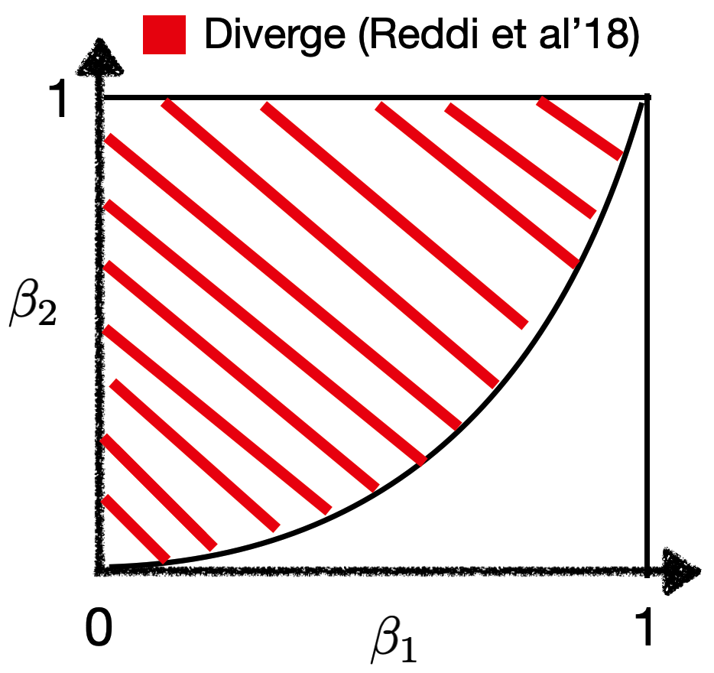
For a long time, Adam is criticized for its divergence issue
Reddi et al. 2018 (ICLR Best paper) :
For any $β_{1}, β_{2}$ s.t. $β_{1}<\sqrt{β_{2}}$, there exists a problem such that Adam diverges.

Slide 7
Why would Adam fail?
Reddi et al. consider the toy problem $\min{\sum_{i=1}^{3}{f_{i}(x)}}$ where
$f_{i}=\left\{\begin{aligned}100x, if i=1 \\ −x, otherwise\end{aligned}\right., x∈[−1,1]$
The movement of Adam is not consistent with negative gradient direction.
Reasons of divergence: 1. About the function: $f_{i}$ differs a lot from each other. 2. About the algorithm: $v_{k}$ distorts the update direction.

Slide 8
How to ensure convergence?
A popular line of work: Modify the algorithm! For instance:
AMSGrad, AdaFom [Reddi et al. 18, Chen et al.18]: keep $v_{k}≥ v_{k−1}$
AdaBound [Luo et al. 19]: Impose constraint: $v_{k}∈[C_{l}, C_{u}]$
etc.
Although these Adam-variants fix the divergence issue, they often bring new issues. For instance:
AMSGrad and AdaFom are reported to be slow [Zhou et al. 18].
AdaBound introduces 2 extra hyperparameters.
On the other hand, Adam remains exceptionally popular. It works well in practice! (either under default setting, or after proper tuning).

Slide 9
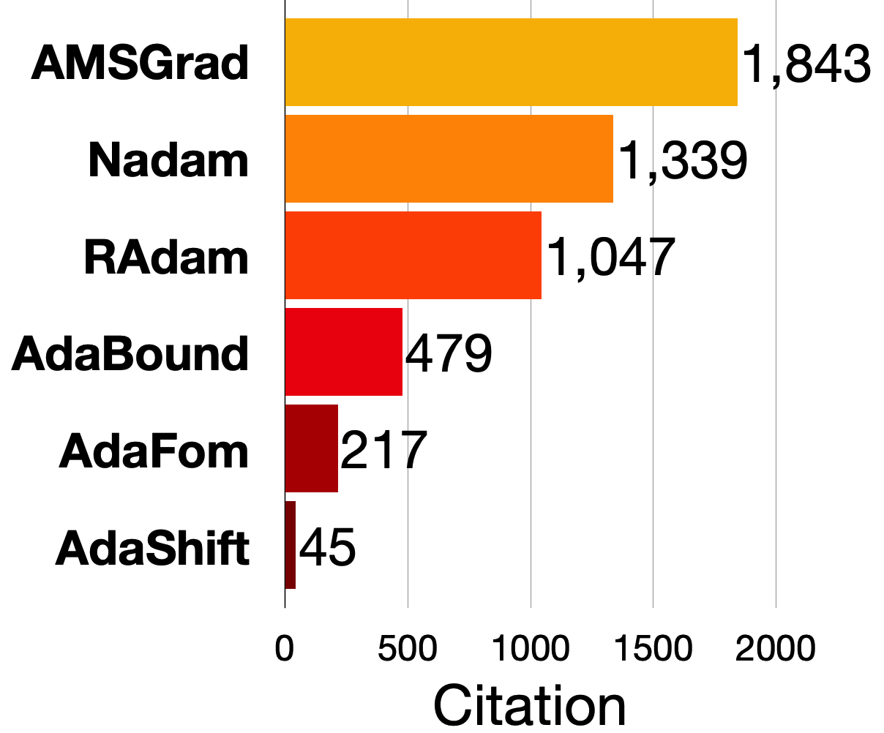
Comparison: Adam vs its variants
*Disclaimer: contribution is not proportional to citation. But citation might reflect the popularity among practitioners.

Slide 10
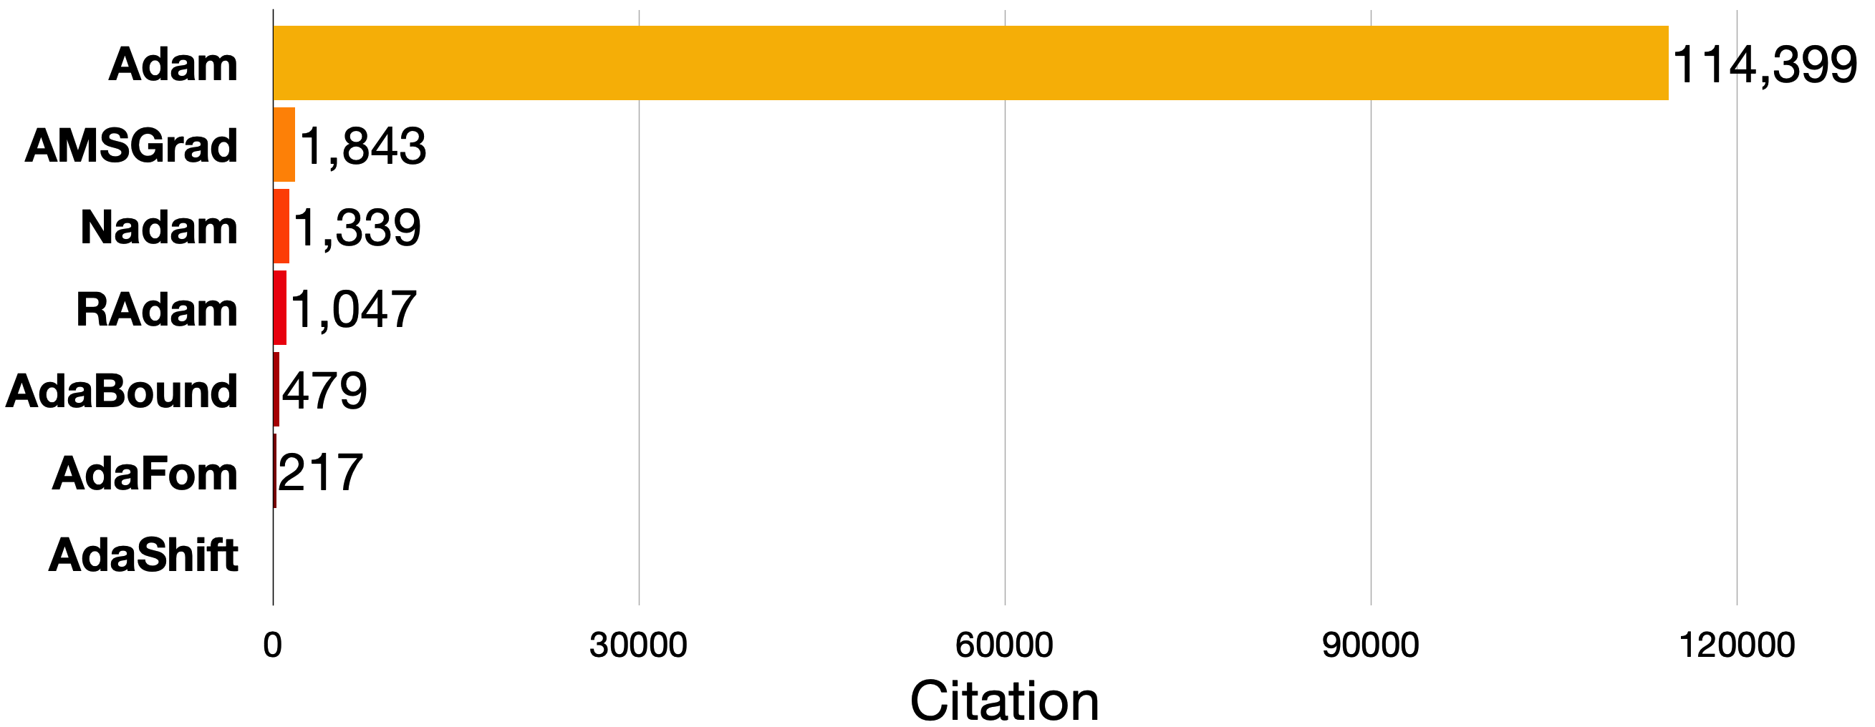
However, Adam remains overwhelmingly popular
The attention Adam received is astonishing!
Partially because many variants bring new issues (e.g., slow)

Slide 11
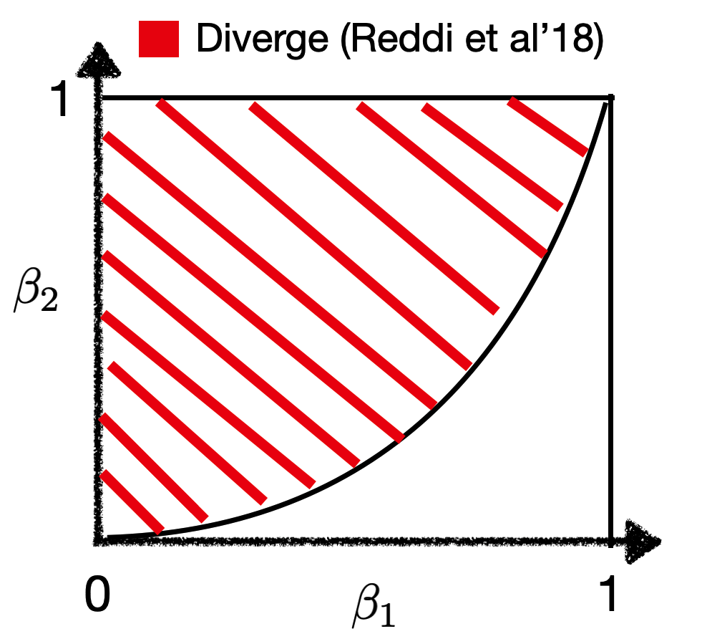
The divergence theory does not go well with practice
We find that the reported $(β_{1}, β_{2})$ in the successful applications actually satisfy the divergence condition $β_{1}< \sqrt{β_{2}}$ !
Most deep learning tasks (e.g. RL, NLP, CV, GAN, etc.): $β_{1}=0.9, β_{2}=0.999$
Conditional GAN, DCGAN, etc: $β_{1}=0.5, β_{2}=0.999$
Is there any gap between theory and practice? Why is the divergence not observed? We want to understand why.
Super-large language models (e.g. GPT-3) $β_{1}=0.9, β_{2}=0.95$
First-order GAN, MSG-GAN:
$β_{1}=0, β_{2}=0.999$

Slide 12
Why is the divergence not observed?
Reddi et al. 18 consider $\min_{x} f(x)≔\sum_{i=1}^{n}{f_{i}(x)}$
An important (but often ignored) feature: Reddi et al. fix $β_{1}, β_{2}$ before picking the problem ($n$ is changing).
While in optimization field, parameters are often problem-dependent (e.g. the step size for GD). As such, the divergence is hardly surprising.
Conjecture 1: Adam might converge under fixed problem (or fixed $n.$)
Proof(Reddi et al. 18): For any fixed $β_{1}, β_{2}$ s.t. $β_{1}<\sqrt{β_{2}}$, we can find an $n$ to construct the divergence example $f(x)$

Slide 13
Why is the divergence not observed?
Reddi et al. 18 consider $\min_{x} f(x)≔\sum_{i=1}^{n}{f_{i}(x)}$
In this example: $f_{i}$ differs a lot from each other. In DL applications: all $f_{i}$ come from a certain underlying non-linear groundtruth mapping (up to certain noise). As such, $f_{i}$ are supposed to be “similar”!
Conjecture 2: Adam can converge when $f_{i}$ are “similar”.
We will verify Conjecture 1 and 2.
$$f_{i}=\left\{\begin{aligned}nx, if i=1 \\ −x, otherwise\end{aligned}\right., x∈[−1,1]$$

Slide 14
Assumptions
Consider $\min_{x}{ f(x)≔\sum_{i=1}^{n}{f_{i}(x)} }$
A1: Assume $∇f_{i}(x)$ are L-Lipschitz continuous.
A2: $\sum_{i=1}^{n}{{|| ∇f_{i} (x)||}_{2}^{2}}≤D_{1}{|| ∇f(x)||}_{2}^{2}+D_{0}$.
A2 says that: ${∇f}_{i}$ are similar up to certain noise.
This is motivated from practical DL tasks.
A2 is quite general. When $D_{1}=\frac{1}{n}$, A2 becomes bounded variance:
$\frac{1}{n}\sum_{i=1}^{n}{{|| ∇f_{i} \left(x\right) −\frac{1}{n} \sum_{i=1}^{n}{∇f_{i}\left(x\right)}||}_{2}^{2}}≤\frac{D_{0}}{n}$ .
A2 allows $D_{1}≠\frac{1}{n}$ and thus it is weaker than bounded variance.
When $D_{0}=0$, A2 becomes ``Strong Growth Condition (SGC)” [Vaswani et al., 19]
When $|| ∇f(x)||$=0 ⟹ we have $|| ∇f_{i}(x)||$=0.

Slide 15
Related works
[Zaheer et al. 18, De et al. 18]: RMSProp(simplified version of Adam with $β_{1}=0$) converges when $β_{2}$ is large.
Requires bounded gradient assumptions: $|| ∇f\left(x\right)||<C$
[Shi et al. 20] prove the convergence of RMSProp without bounded gradient assumption.
It is important to study Adam rather than RMSprop:
Numerically: Adam outperforms RMSprop on complicated tasks:
On Atari , the mean rewarded is improved from 88% to 110% [Agarwal et al.20; Jiang 20]
Theoretically: CANNOT reveal the interaction between $β_{1}$ and $β_{2}$.
[Huang et al. 21] and [Guo et al. 22]: Under large $β_{1}$, Adam can converge. They require:
A3: Assume $|| ∇f\left(x\right)||<C$.
A4: Assume ${ v}_{k}∈\left[C_{l}, C_{u}\right]$.
This line of work is restricted to AdaBound.
To our knowledge, A1+ A2 are the mildest assumption so far.

Slide 16
Related works
[Zaheer et al. 18, De et al. 18, Shi et al. 20]: RMSProp(simplified version of Adam with $β_{1}=0$) can converge.
It is important to study Adam rather than RMSprop:
Numerically: Adam outperforms RMSprop on complicated tasks:
On Atari, the mean rewarded is improved from 88% to 110% [Agarwal et al.20; Jiang 20]
Theoretically: CANNOT reveal the interaction between $β_{1}$ and $β_{2}$.
[Huang et al. 21] and [Guo et al. 22]: Under large $β_{1}$, Adam can converge. They require:
A3: Assume $|| ∇f\left(x\right)||<C$.
A4: Assume ${ v}_{k}∈\left[C_{l}, C_{u}\right]$.
This line of work is restricted to AdaBound.
To our knowledge, A1+ A2 are the mildest assumption so far.

Slide 17
Convergence results for large $β_{2}$
Theorem 1: Consider the previous setting. When $β_{2}≥1−O\left(\frac{1−β_{1}^{n}}{n^{3.5} }\right)$ and $β_{1}< \sqrt{β_{2}}<1$, Adam with stepsize $η_{k}=\frac{1}{√k}$ converges to the neighborhood of stationary points.
$\min_{k∈[1, T]}{𝔼|| ∇f\left(x_{k}\right) ||_{2}^{2}=O(\frac{\log{T}}{\sqrt{T}}+\left(1−β_{2}\right)D_{0})}$
Remark: When $D_{0}=0$: Adam converges to stationary points.

Slide 18
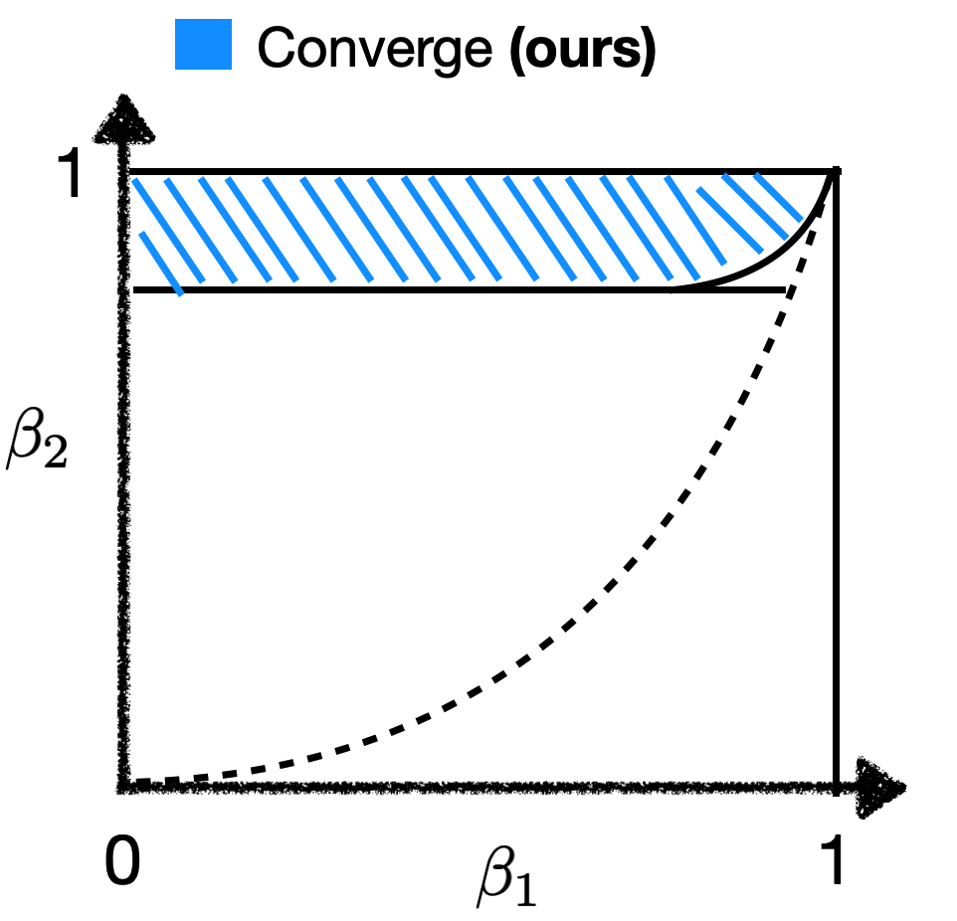
Convergence results for large $β_{2}$
Intuition: Large $β_{2}$ weaken the movement of $v_{k}$
Previously, the majority of the region is claimed to be dangerous. (when fixing $β_{2}$ first) While we successfully identify a safe region (when choosing $β_{2}$ according to $n$).
Our result helps explain why Adam works well in practice (e.g. NLP, CV applications): They choose hyperparameters in the safe region.

Slide 19
Remark: Convergence to neighborhood.
When $D_{0}=0:$ converges to stationary points.
When $D_{0}>0:$ converges to the neighborhood of stationary points with size$O(\left(1−β_{2}\right)D_{0})$. (often called ``ambiguity zone”).
This is common for constant-step SGD [Yan et al., 2018; Yu et al., 2019]
and diminishing-step Adaptive gradient methods [Zaheer et al., 2018; Shi et al., 2020]:
$$x_{k+1}=x_{k} −\frac{η_{k}}{\sqrt{v_{k}}}m_{k}$$
Although $η_{k}$ is diminishing, $\frac{η_{k}}{\sqrt{v_{k}}}$ may not decrease.

Slide 20
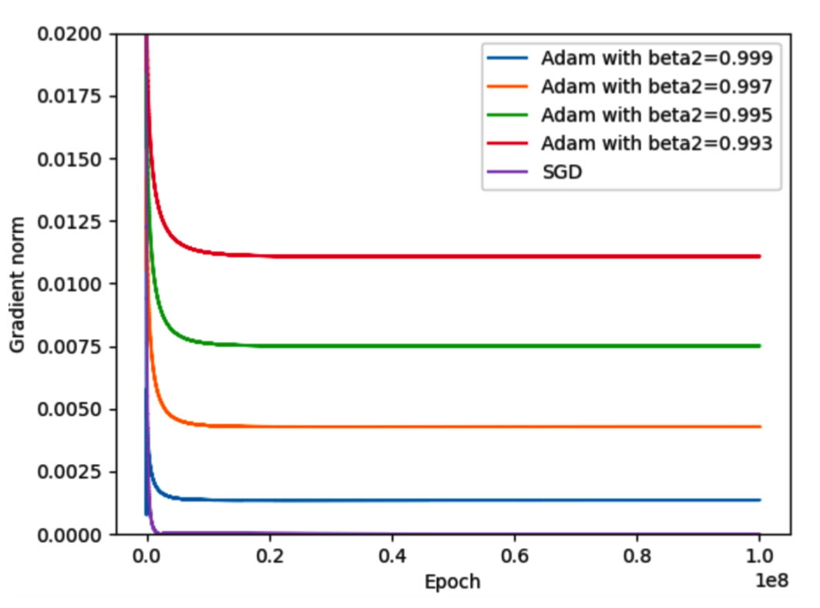
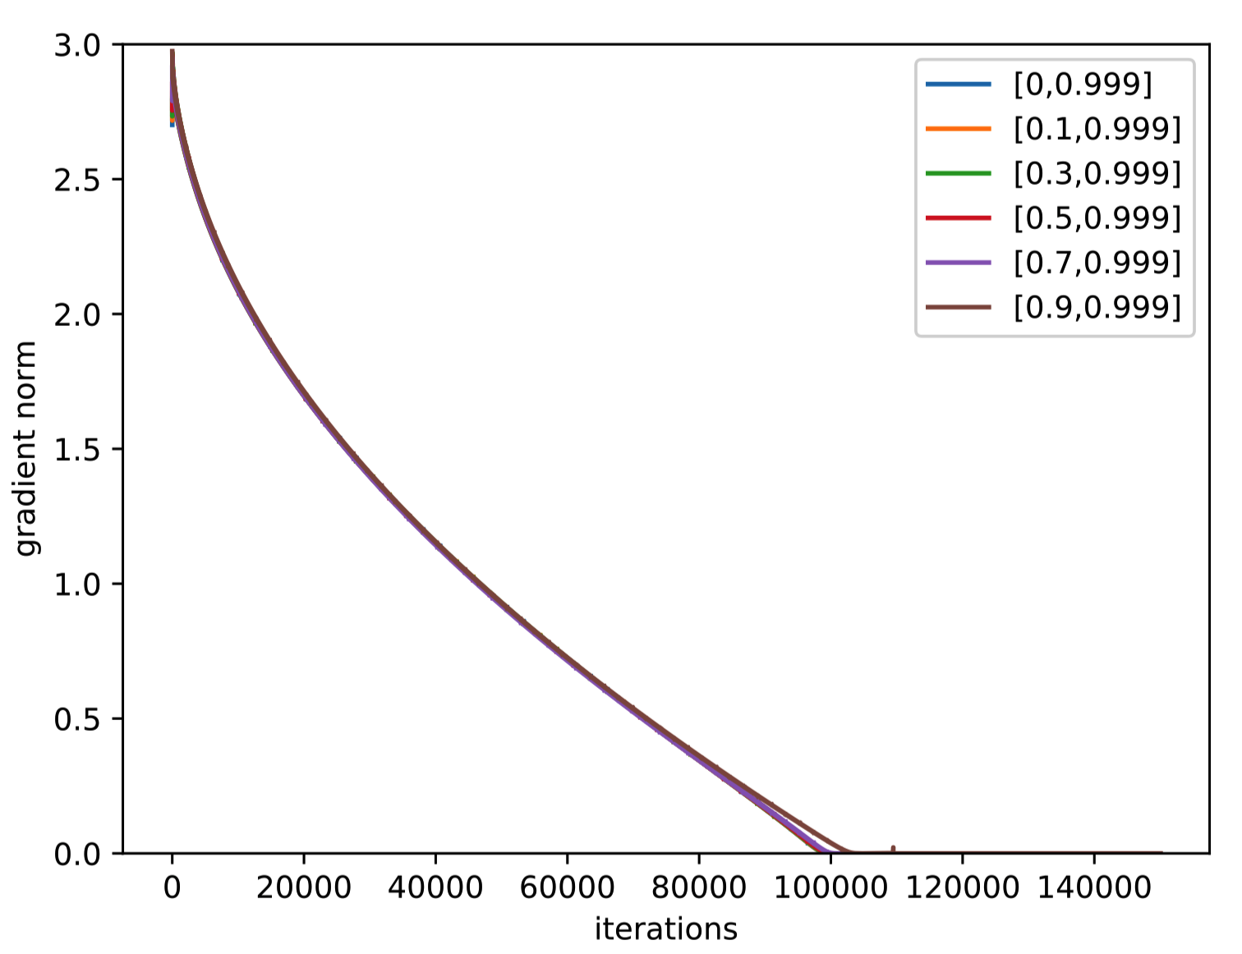
Remark: Convergence to neighborhood.
Left: An example with $D_{0}>0$
Right: An example with $D_{0}=0$
Setting: Consider Adam & SGD with stepsize $η_{k}=\frac{1}{√k}$

Slide 21
Techniques for proving convergence
To prove convergence, we want to show:
$𝔼\left\langle ∇f\left(x\right),\frac{m_{k}}{\sqrt{v_{k}}}\right\rangle =\left\langle ∇f\left(x\right),\frac{\left(1−β_{1}\right)∇f_{τ_{k}}\left(x_{k}\right)+β_{1}m_{k−1} }{\sqrt{\left(1{−β}_{2}\right)∇f_{τ_{k}}\left(x_{k}\right)∘∇f_{τ_{k}}\left(x_{k}\right)+β_{2}v_{k−1}}}\right\rangle$> 0
We point out there are at least two challenges
We provide a new method to overcome these two challenges.
Proof techniques: Stochastic non-linear dynamics analysis;
random permutation analysis.
Challenge 1: massive momentum. When $β_{1}$ is large, $m_{k}$ contains heavy historical signals. Even for SGDmomentum, controlling momentum error is non-trivial [Liu et al. 20].
Existing methods: Setting $β_{1}→0$ [Zaheer et al., 2018; De et al., 2018; Shi et al., 2020]. However, we are interested in any $β_{1}∈[0,1)$
Challenge 2: non-linear perturbation. $v_{k}$ makes the whole system a non-linear dynamics.
$v_{k}$ also contains heavy history signal. Further, $v_{k}$ is statistically dependent with $m_{k}$. So $𝔼\left[\frac{m_{k}}{\sqrt{v_{k}}}\right]≠𝔼\left[m_{k}\right]𝔼\left[\frac{1}{\sqrt{v_{k}}}\right]$

Slide 22
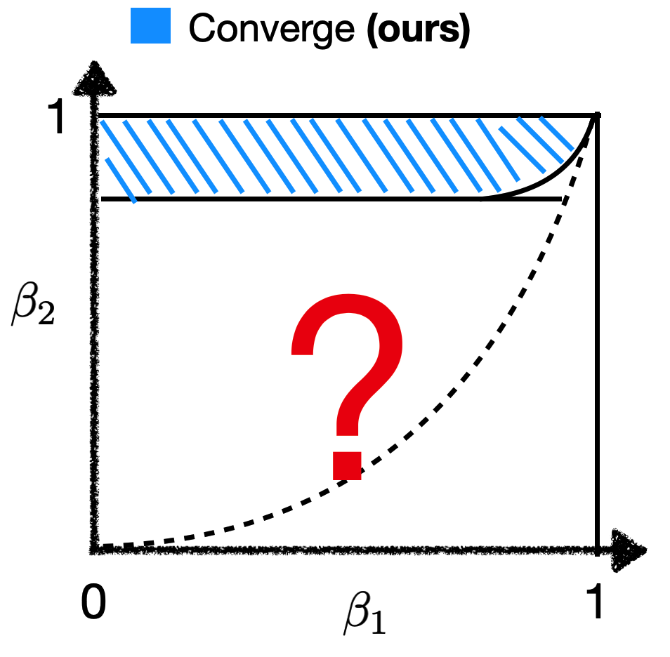
How does Adam behave in the rest of the region?
When $β_{2}$ is large: we have shown a positive result.
When $β_{2}$ is small: we will show that Adam can still diverge! (even if the problem class is fixed)

Slide 23
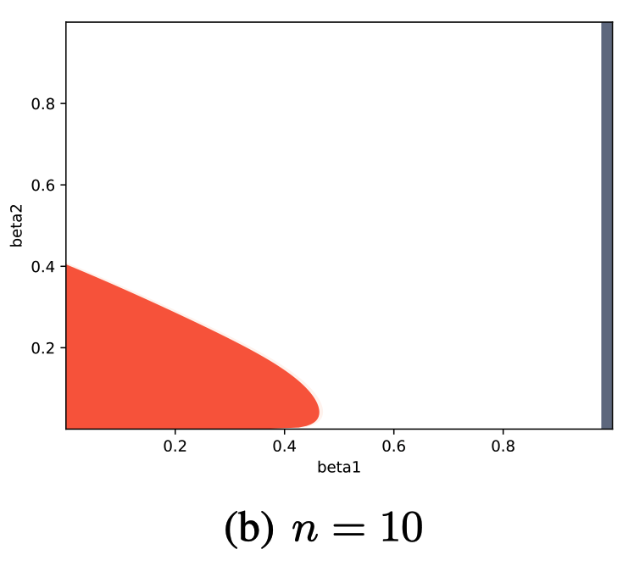
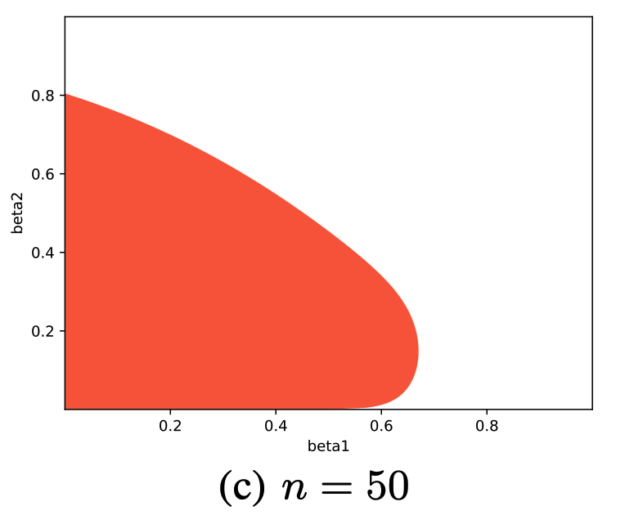
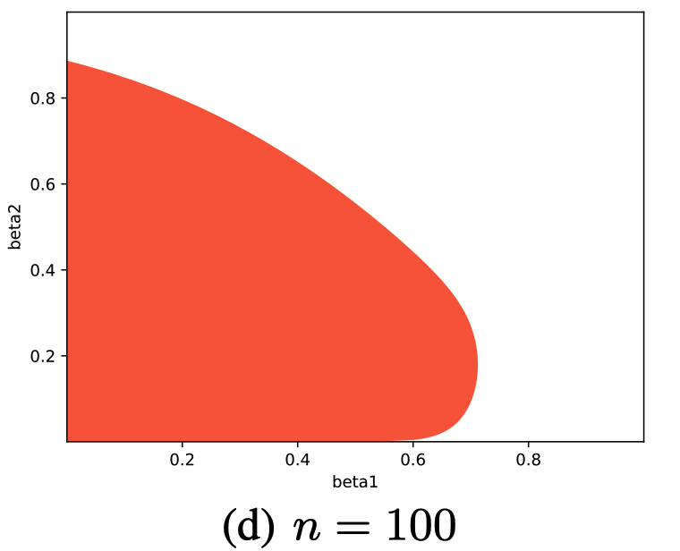
Divergence can happen when $β_{2}$ is small
Thm 2: for any fixed n, there exists a function $f(x)$ satisfying A1 and A2, s.t. when $(β_{1},β_{2})$ are chosen in the orange region (size depends on $n$), Adam’s iterates and function values diverge to infinity
The region is plotted by solving some analytic conditions.

Slide 24
Some remarks on the divergence theorem
Remark 1: The size of the orange region depends on $n$ and it expands to the whole region when $n$ goes to infinity. (Both in theory and experiments)
This also matches our convergence theorem: for larger $n,$ we need larger $β_{2}≥1−O\left(\frac{1−β_{1}^{n}}{n^{3.5} }\right)$ to ensure convergence.

Slide 25
Some remarks on the divergence theorem
Remark 1.1: The size of the orange region depends on $n$
Our bound is problem-dependent.
This is which is drastically different from (Reddi et al., 2018) which established the problem-independent worst-case choice of $β_{1}$ and $β_{2}$.
Remark 1.2: The region expands to the whole region ${\left[0,1\right]}^{2}$ when $n$ goes to infinity.
When $n→∞$, our result recovers (actually stronger than) the problem-independent divergence result of (Reddi et al., 2018).
We can view the divergence result of (Reddi et al., 2018) as an asymptotic characterization and our divergence result as a non-asymptotic characterization (for any fixed n).

Slide 26
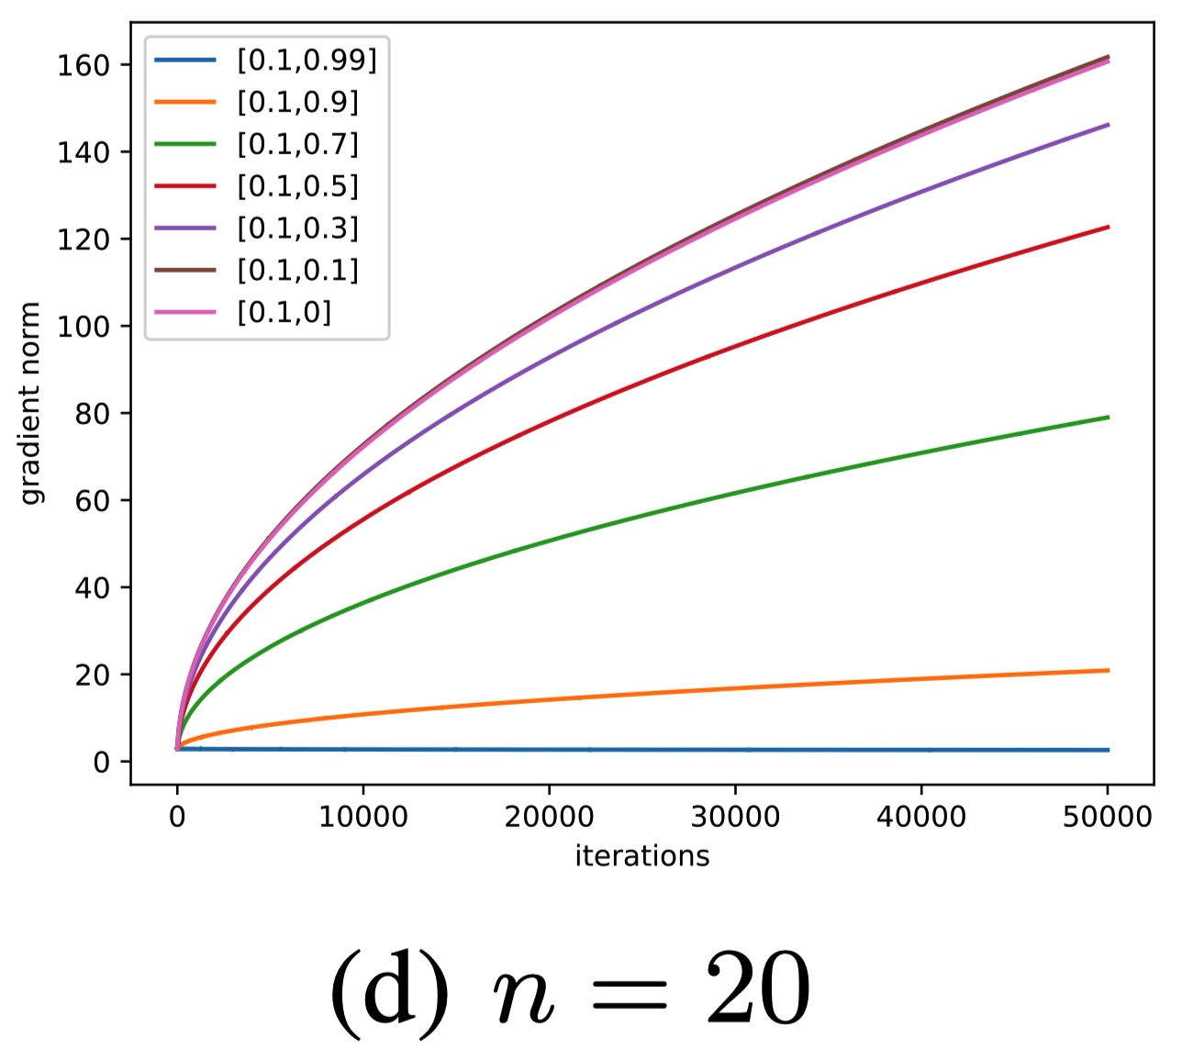
Some remarks on the divergence theorem
Remark 2: For Adam, it is important to remove the bounded gradient assumption!!!
In practice, the gradient of iterates can be unbounded.

Slide 27
Intuition behind convergence and divergence
Adam: $x^{t+1}=x^{t} −η_{t}\frac{m_{t}}{√v_{t}}$
$$β_{2}=1$$
E(-$\frac{m_{t}}{√v_{t}})$
1
$$−∇f(x_{t})$$
$$−∇f(x_{t})$$
Converge
E(-$\frac{m_{t}}{√v_{t}})$
$$−∇f(x_{t})$$
E(-$\frac{m_{t}}{√v_{t}})$
Diverge
$$β_{2}=0$$
E(-$\frac{m_{t}}{√v_{t}})$
$$−∇f(x_{t})$$
0

Slide 28
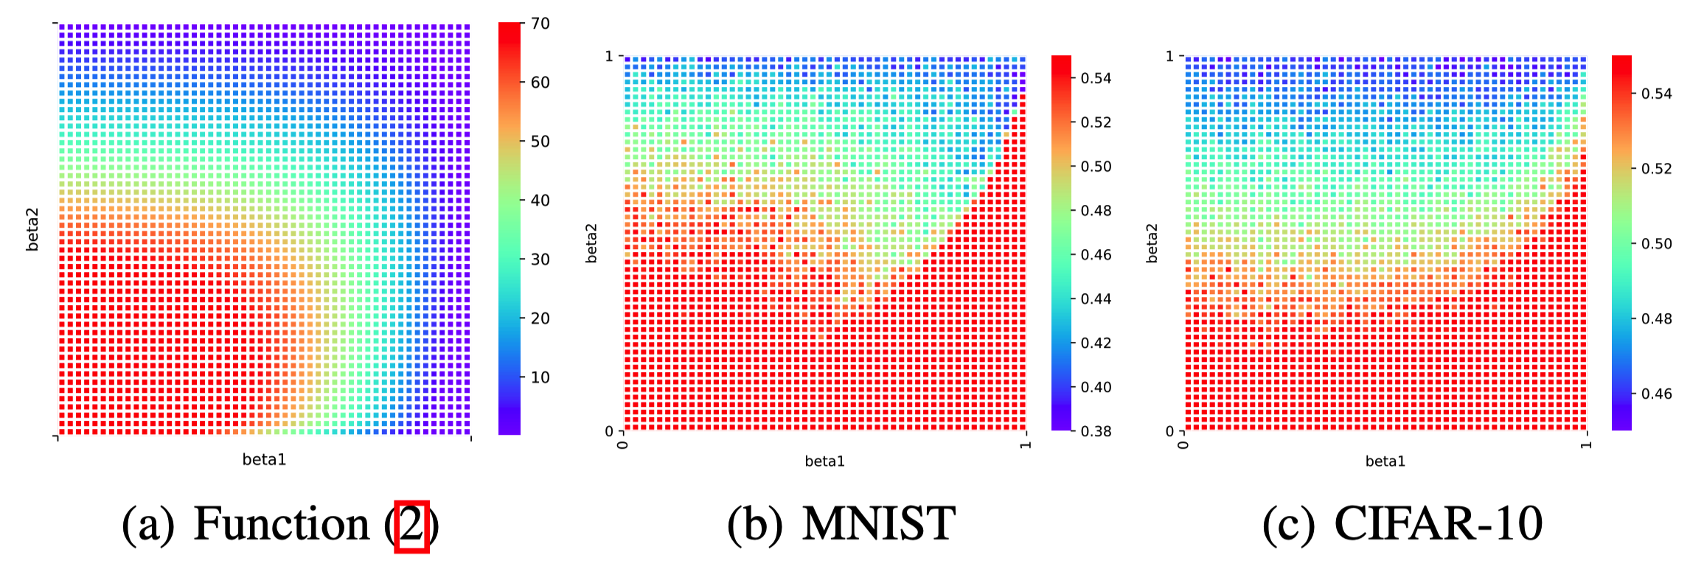
Our theory is consistent with experiments
Smooth boundaries
Optimization error is larger in the red region
Optimization error is small in the top blue region

Slide 29
Intuition behind convergence and divergence
When $β_{1}≠0$: $x^{t+1}=x^{t} −η_{t}\frac{m_{t}}{√v_{t}}$
$$β_{1}=0$$
$$β_{1}=1$$
1
E(-$\frac{m_{t}}{√v_{t}})$
E(-$\frac{m_{t}}{√v_{t}})$
$$β_{2}=1$$
$$−∇f(x_{t})$$
$$−∇f(x_{t})$$
$$−∇f(x_{t})$$
$$−∇f(x_{t})$$
E(-$\frac{m_{t}}{√v_{t}})$
$$−∇f(x_{t})$$
$$−∇f(x_{t})$$
E(-$\frac{m_{t}}{√v_{t}})$
E(-$\frac{m_{t}}{√v_{t}})$
E(-$\frac{m_{t}}{√v_{t}})$
E(-$\frac{m_{t}}{√v_{t}})$
$$−∇f(x_{t})$$
$$−∇f(x_{t})$$
0
$$β_{2}=0$$

Slide 30
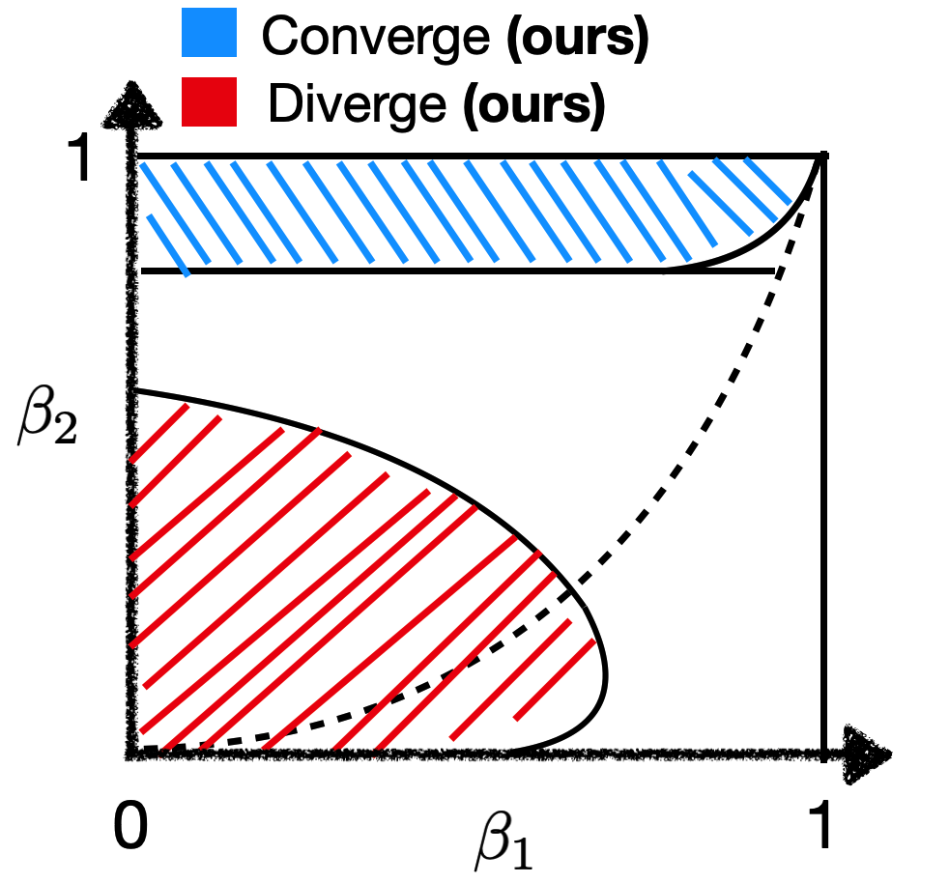
Summary: the behavior of Adam changes dramatically under different hyperparameters
When increasing $β_{2}$: There is a phase transition from divergence to convergence.
Setting | Hyperparameters | Adam’s behavior
$∀f\left(x\right)$ under A1 and A2 with $D_{0}=0$ | $β_{2}$ is large and $β_{1}<\sqrt{β_{2}}$ | Converges to stationary points (Ours)
$∀f\left(x\right)$ under A1 and A2 with $D_{0}>0$ | $β_{2}$ is large and $β_{1}<\sqrt{β_{2}}$ | Converges to the neighborhood of stationary points (Ours)
$∃ f\left(x\right)$ under A1 and A2 | $β_{2}$ is small and a wide range of $β_{1}$ | Diverges to infinity (Ours)

Slide 31
Implication to practitioners
Case study: Bob is using Adam to train NNs. However, Adam with default hyperparamter fails in his tasks.
Bob heard there is a well-known result that Adam can diverge.
So he wonders: shall I keep tuning hyperparameter to make it work?
Or shall I just give up and switch to other algorithms like AdaBound (which has 2 extra hyperparameters)?
Our suggestions:
Adam is still a theoretically justified algorithm. Please use it confidently!
Suggestions for hyperparameter tunning: First, tune up $β_{2}$. Then, try different $β_{1}$ with $β_{1}<\sqrt{β_{2}}$

Slide 32
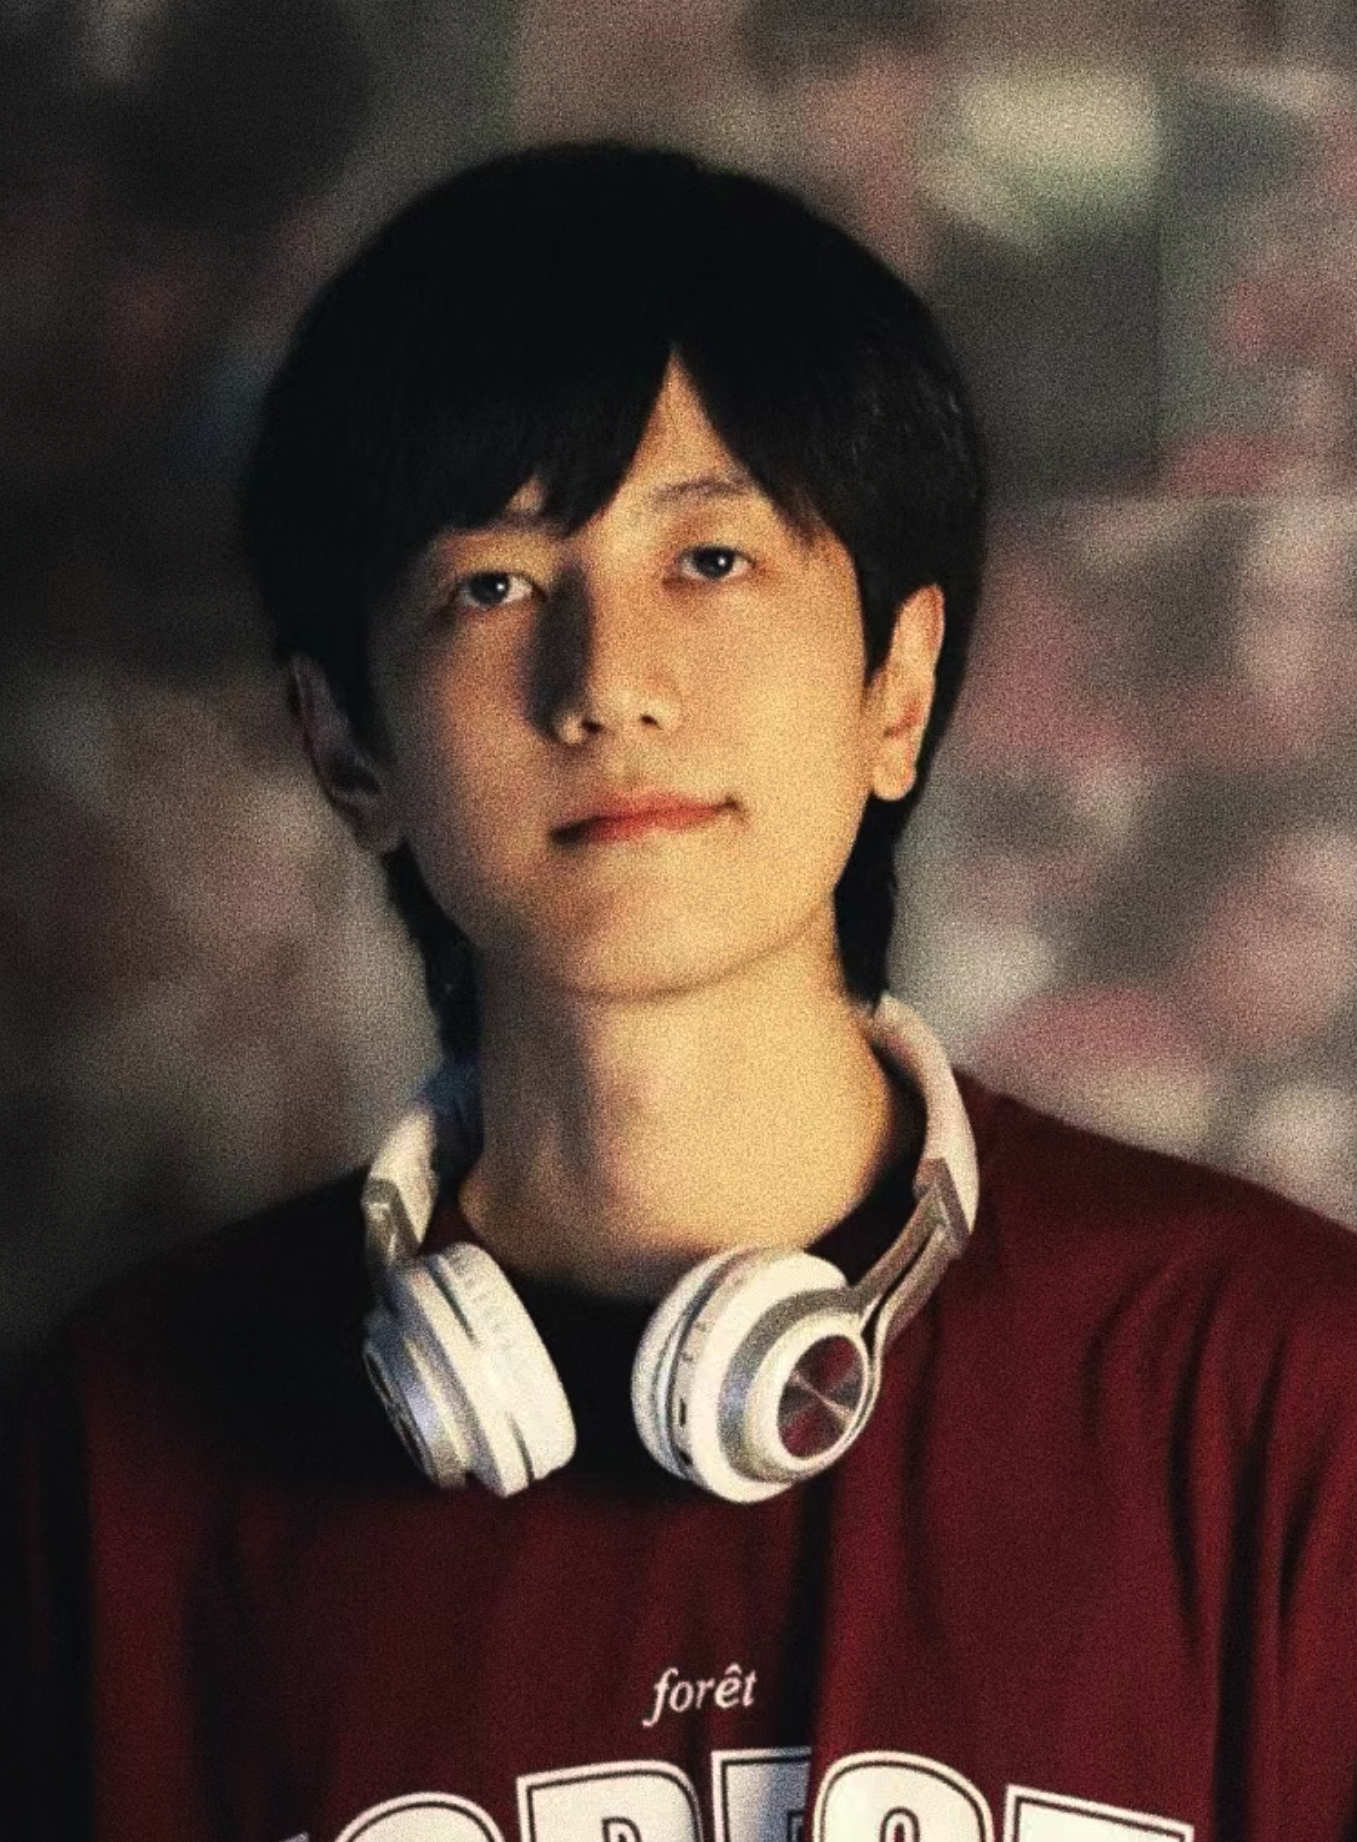
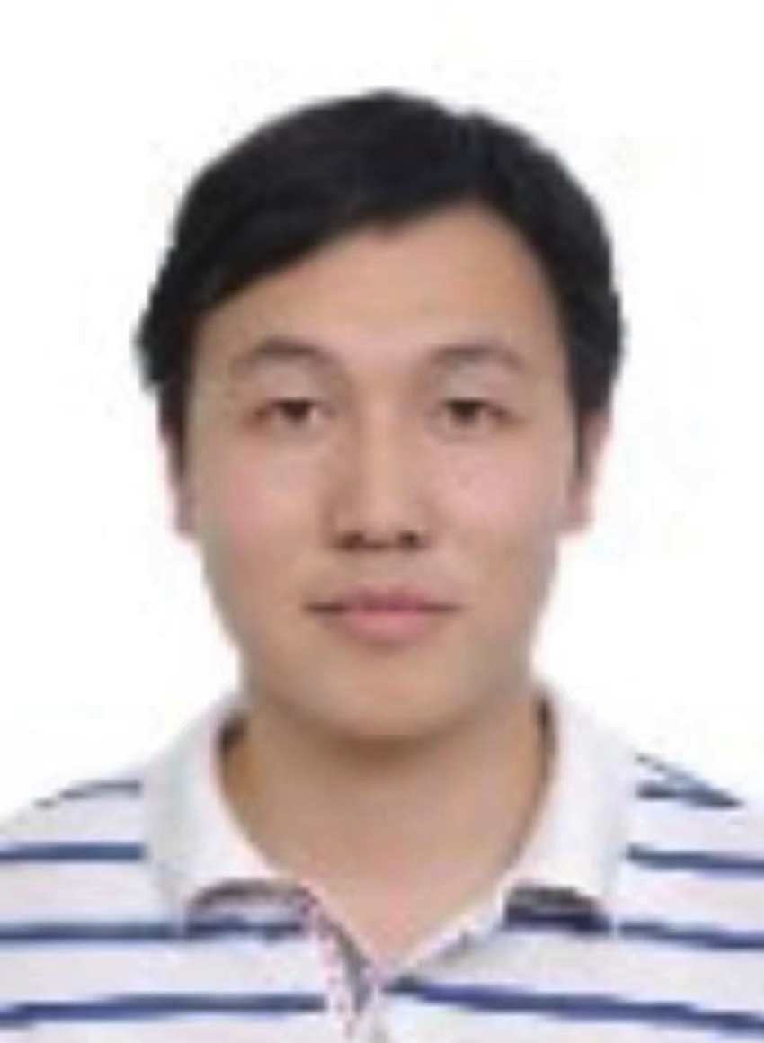
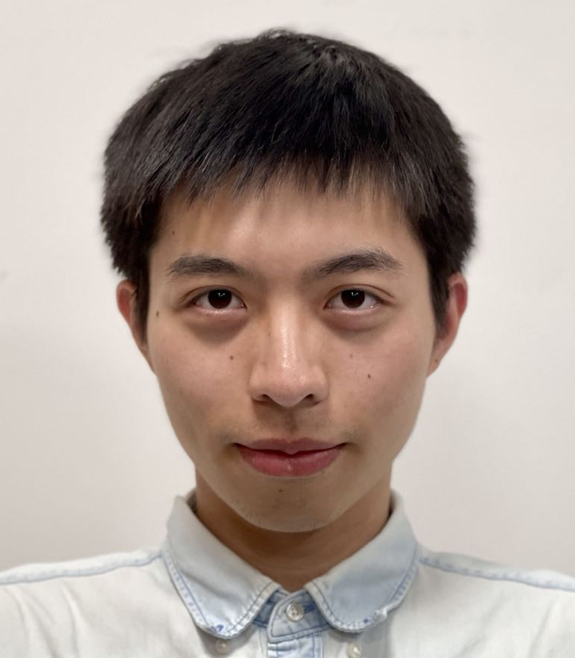
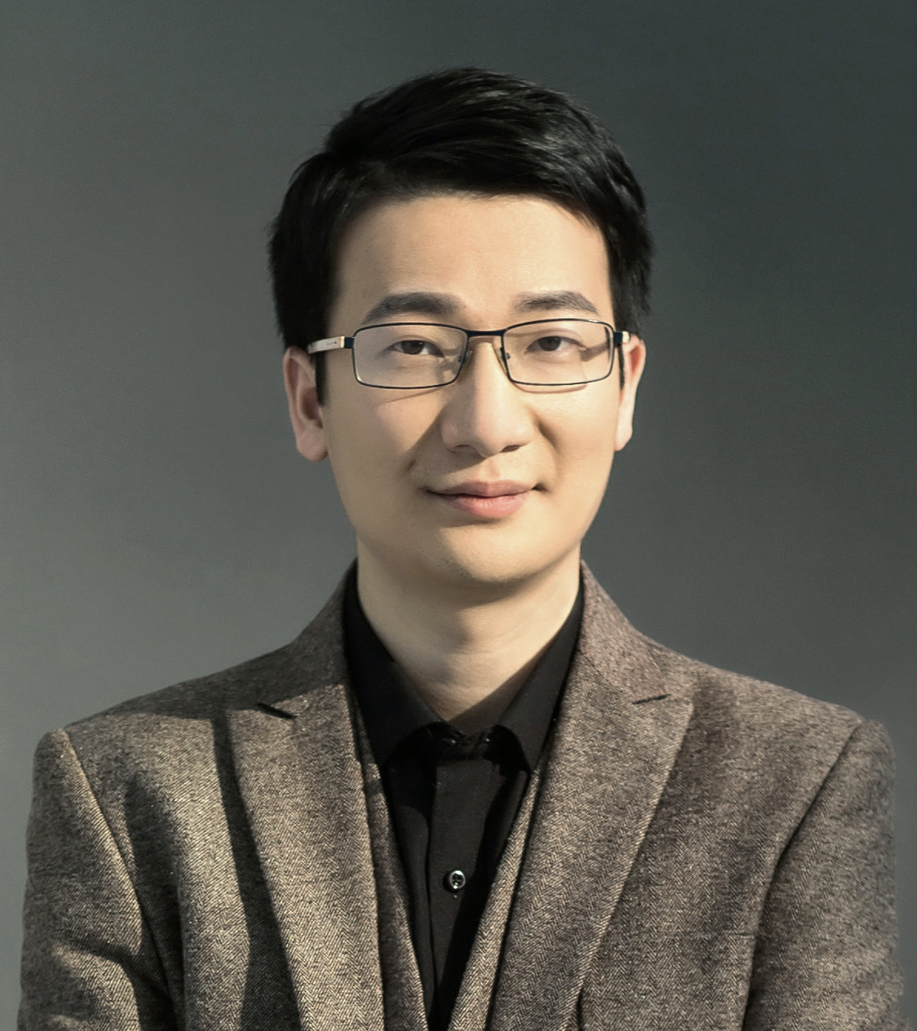
Mainly based on:
[1] Adam Can Converge Without Any Modification on Update Rules (Under review) .
Yushun Zhang, Congliang Chen, Naichen Shi, Ruoyu Sun, Zhi-Quan Luo
Thanks to all the collaborators!

